Slide 1
BetterCap
Network Traffic Analysis and Statistics

Slide 2
Table of Contents
01
02
03
4
Network Traffic
What is it? What can we learn from it?
Targeted Network Activities
Which types of network activities we can process?
How To Detect
How to detect malicious activity on network?

Slide 3

Network Traffic Analysis
Network traffic analysis is a process of capturing packets to increase our understanding of network flow. It allow us to detect incoming attacks.

Slide 4
Targeted Network Activities
DDos Attacks
Arp Poisoning Attacks
01
02
One of the common attack type used to take down websites .
It uses a device in the network commence attacks
Torrent Activity
03
It can create bandwith problems in the network.

Slide 5
Real User or DDos Agent
01
02
Real User
DDos Agent
Sends different types of packets with different options .
Spesific packets designed to wear down server. Packets are same type and more alike.

Slide 6
Traffic Mapping for DDos Attacks
Filter the packets that should be shown in map
Ask the locations to the
Api
Day 1
Day 2
Day 3
Day 4
Get the source IP addresses from selected packets
Mark the locations the map

Slide 7

Arp Poisoning
Can block acces
Information Gathering
Alter The Packets
It can block all internet acces entirely.
Attacker can acces sensitive data and exploit it to go deeper.
It can impersonete any device and alter the flow entirely.

Slide 8
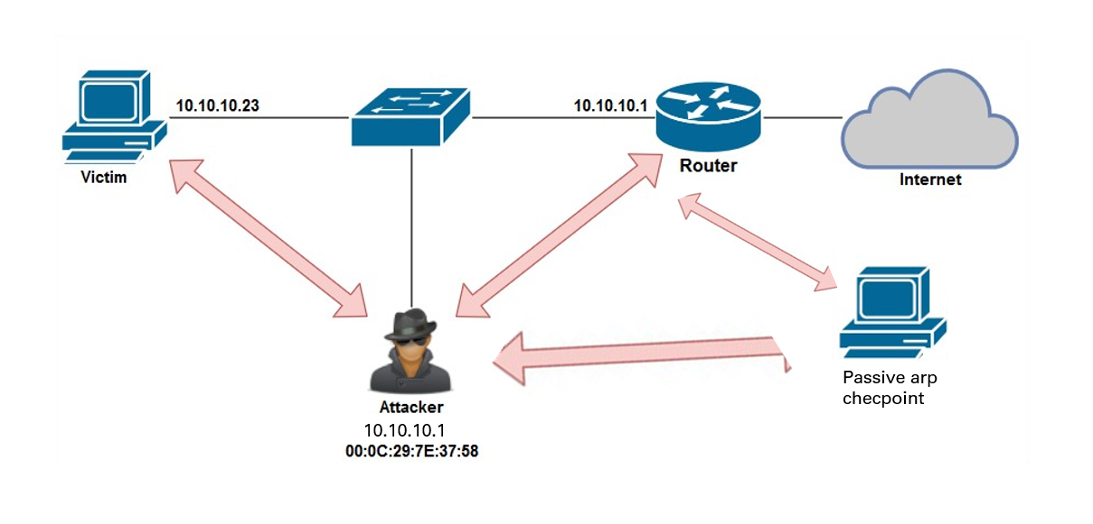
Detecting The Imposter
We can detect malicious devices that alters Arp tables at 3 step
Request real mac adress of gateway
Listen the arp advertasings
Check if arp packets are malicious

Slide 9

Torrent Countermeasures
Torrent networks uses BT-DHT protocol to increase the decentralization. This protocol is easy to detect in local network.

Slide 10
Thanks!
Do you have any questions?
Mert Can DENLİ
mertcandenli3@gmail.com
Please keep this slide for attribution

Slide 11


